Slide 1
In Fill Gain Corrections: E/p vs Laser Sam Grant UCL Muons Meeting 25th June 2019

Slide 2
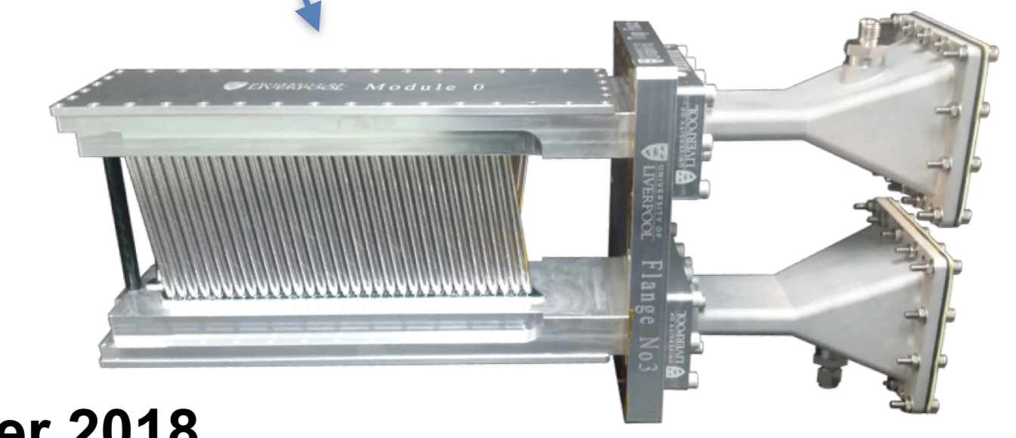
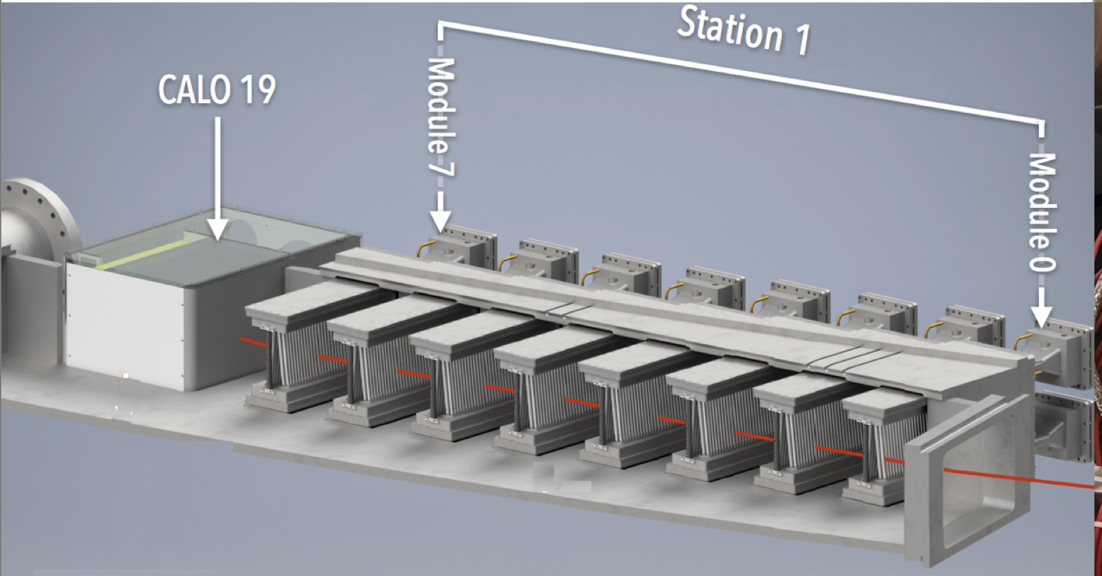
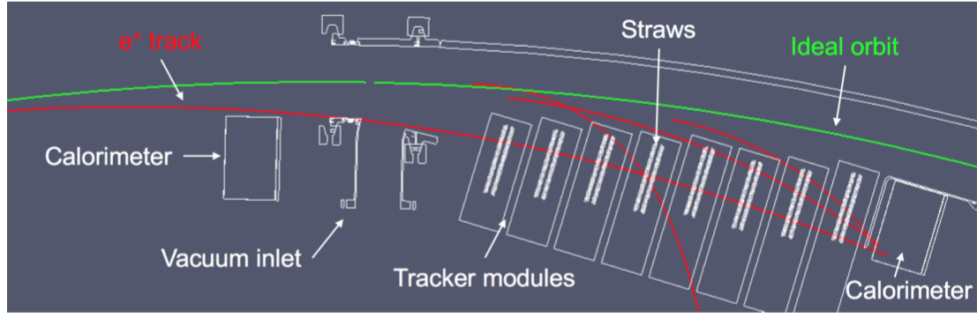
Trackers
Layers of wire under high voltage, encased in straws filled with an argon-ethane gas mix
Provides information about track momentum and position
Two sets of 8 modules, in front of calorimeters 13 and 19.
Very useful for studying systematics as well!
Ionisation -> Charges drift to wires -> Read out and reconstruct -> No worries

Slide 3
Calos
24 Calorimeters
54 Scintillating Crystals per Calo
Tracks can be matched between tracker and calo

Slide 4
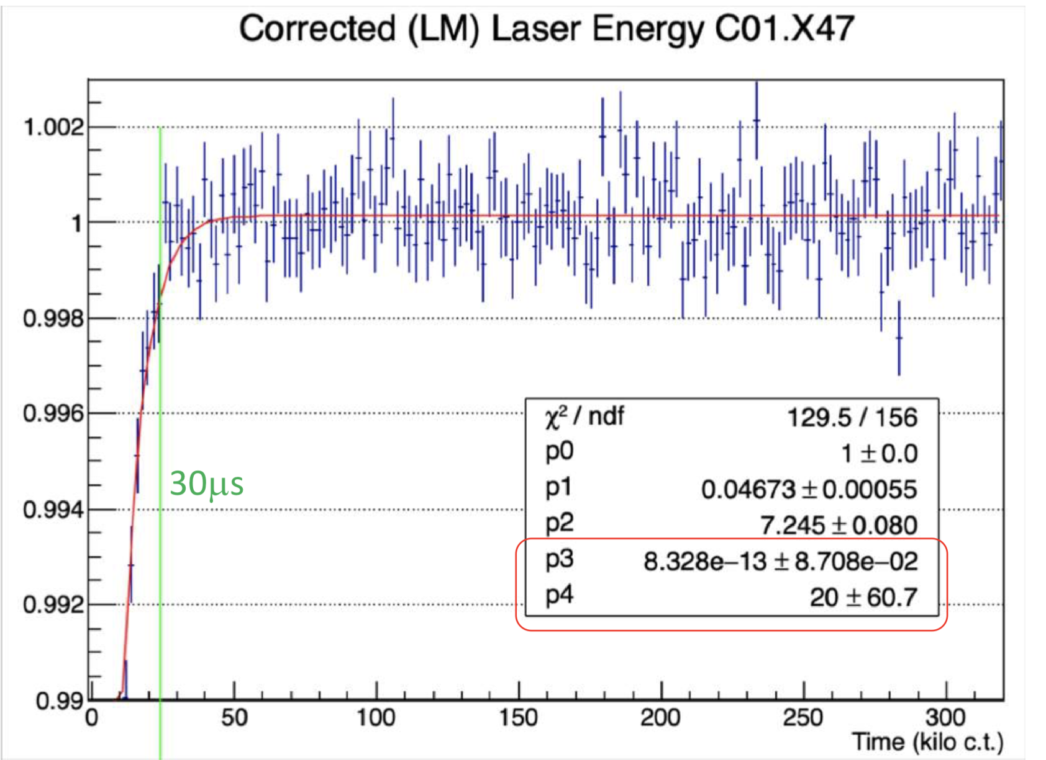
Gain sag!
Sudden drop and subsequent recovery in gain at early times
This is due to bunching after injection saturating the calorimeters
Must be fitted and corrected in processing
Amplitude p₁ and time constant p₂ are used for gain corrections

Slide 5
The E/p ratio
Tracker-calo matched tracks provide a different way to measure gain, so we can perform an independent cross check of the laser.
Gain = measured energy / true energy
E = p, and trackers do not “see” gain sag, so:
Gain = cluster energy (calo) / track momentum (tracker)
Gain = E/p

Slide 6
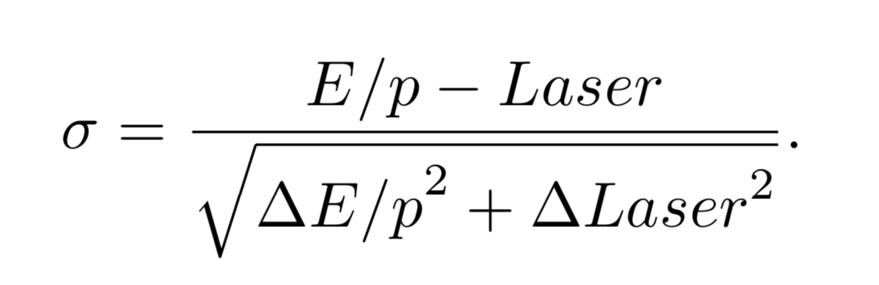
Overview
Derive the recovery times and amplitudes using E/p
Quantify the level of deviation between laser and E/p:
We can use the pull per crystal in units of sigma
As well as the fractional uncertainty per crystal

Slide 7
Cuts on fits per crystal
//QUALITY CUTS
// Require high stats
if (N < 50000) continue;
// Require reasonable reduced chi squared
if(chiSqrNDF < 0.25 || chiSqrNDF > 4) continue;
// Require low error
if( tau_err > 0.5*tau || A_err > 0.5*A) continue;

Slide 8
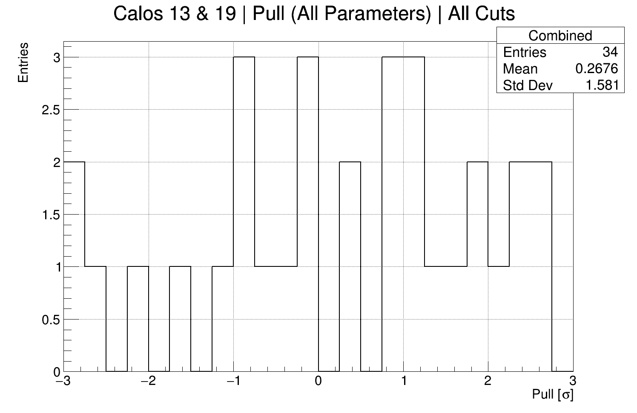
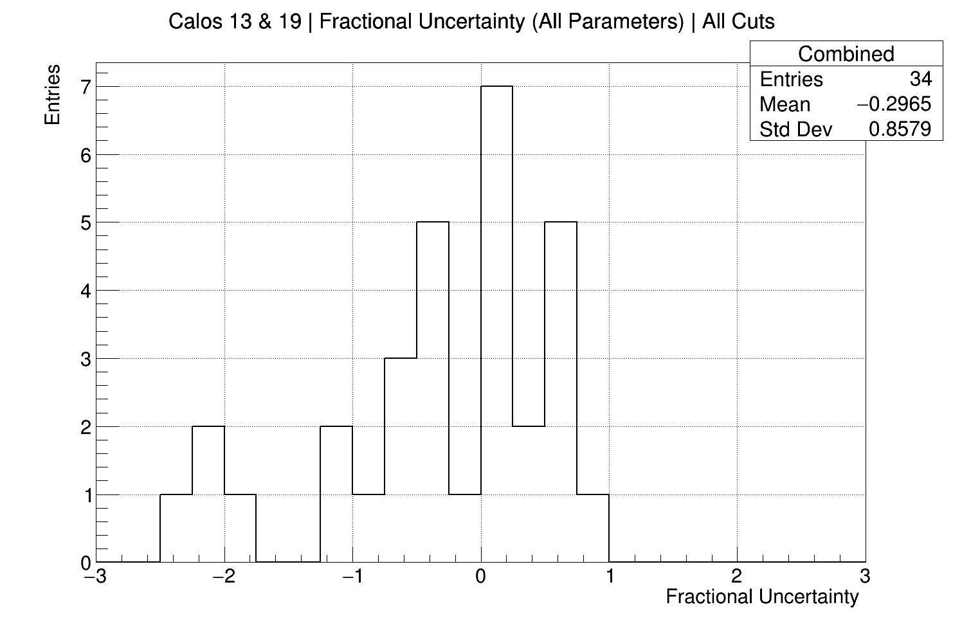
Cuts Illustration (1D Distributions)
You might expect a nice gaussian, with sigma = the percentage uncertainty of the laser results...
Why are there outliers?

Slide 9
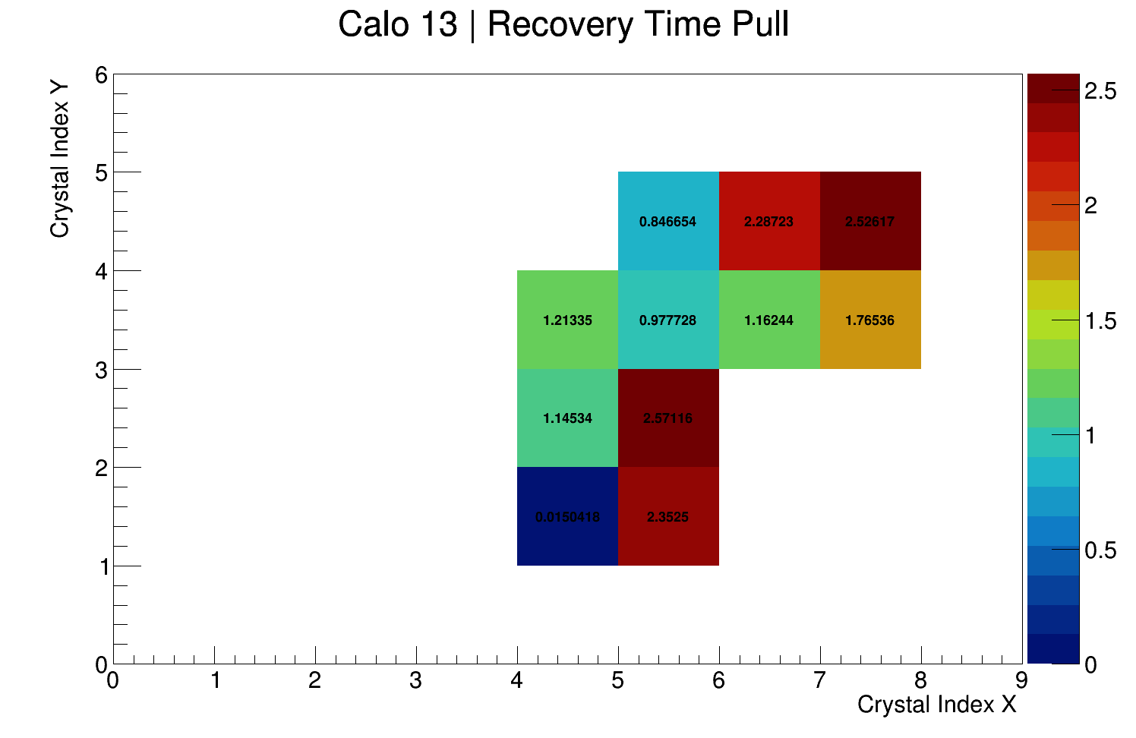
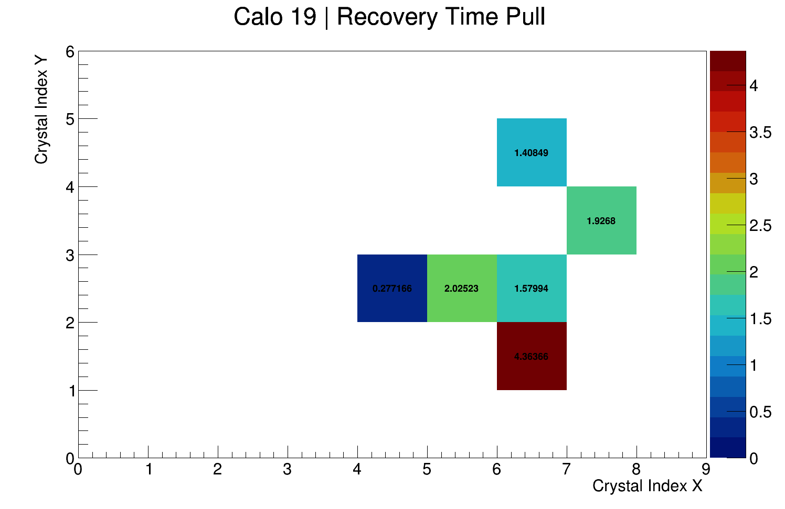
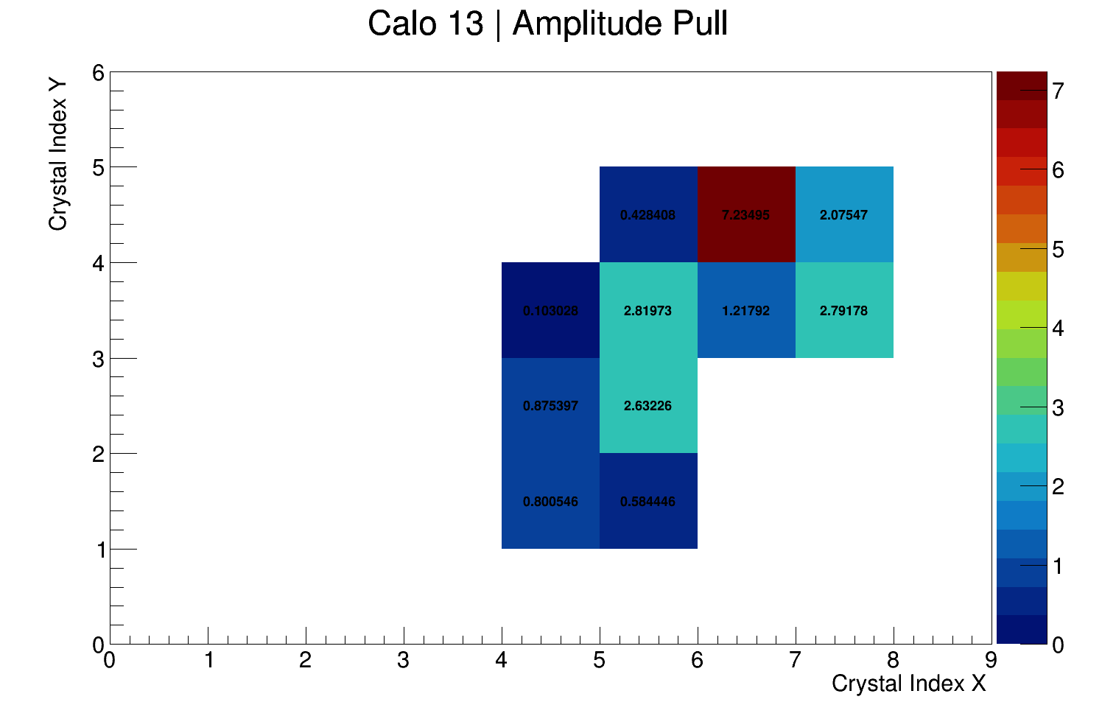
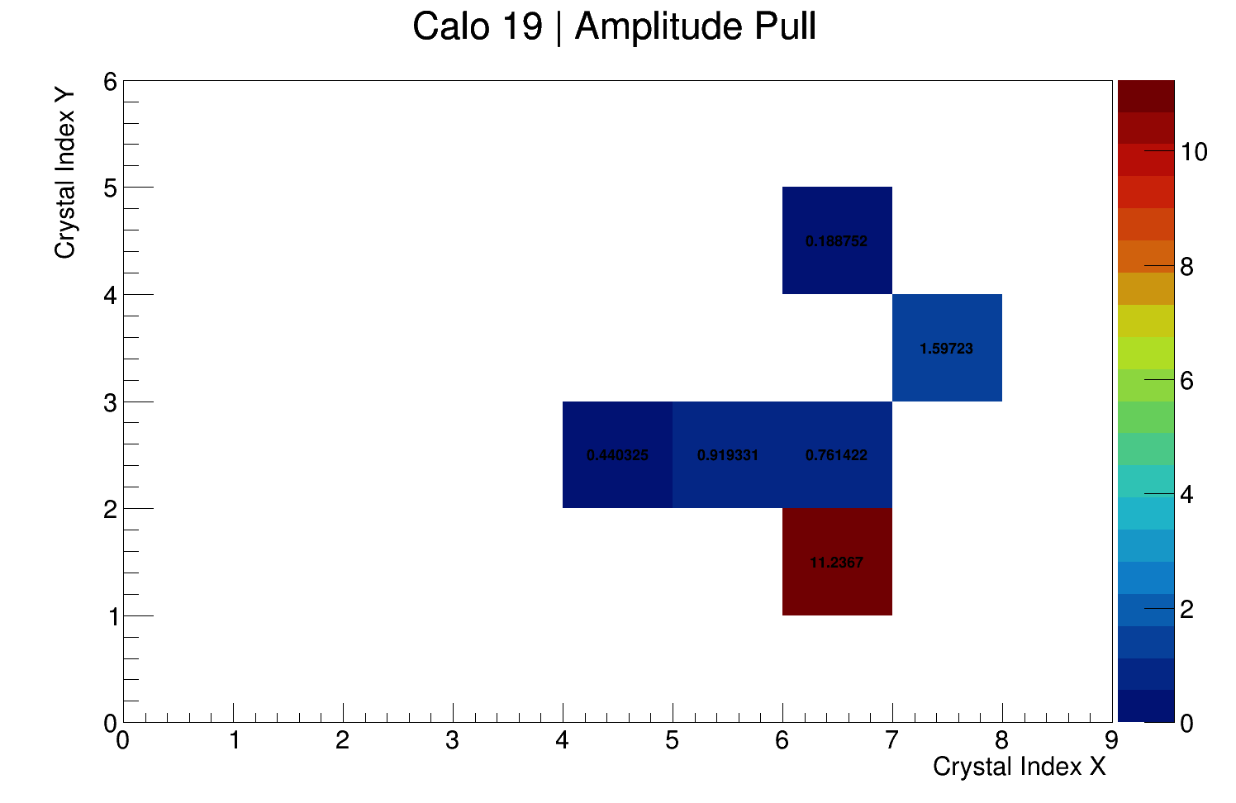
Cuts Illustration (Pull)

Slide 10
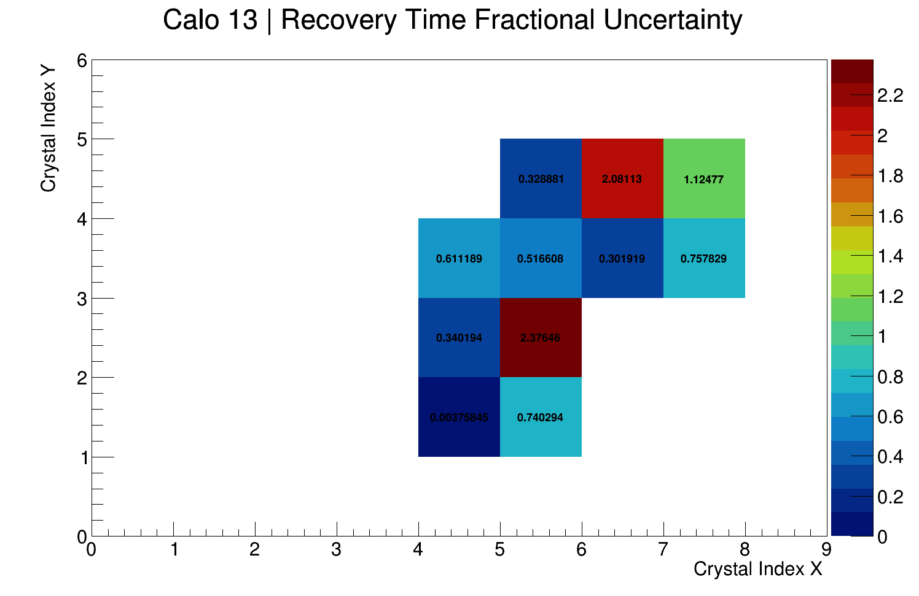
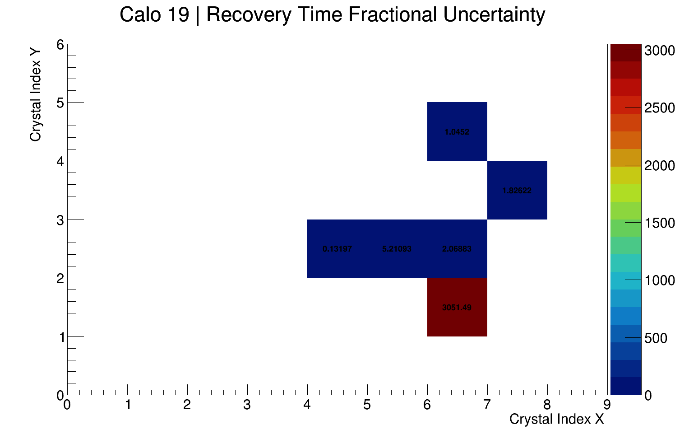
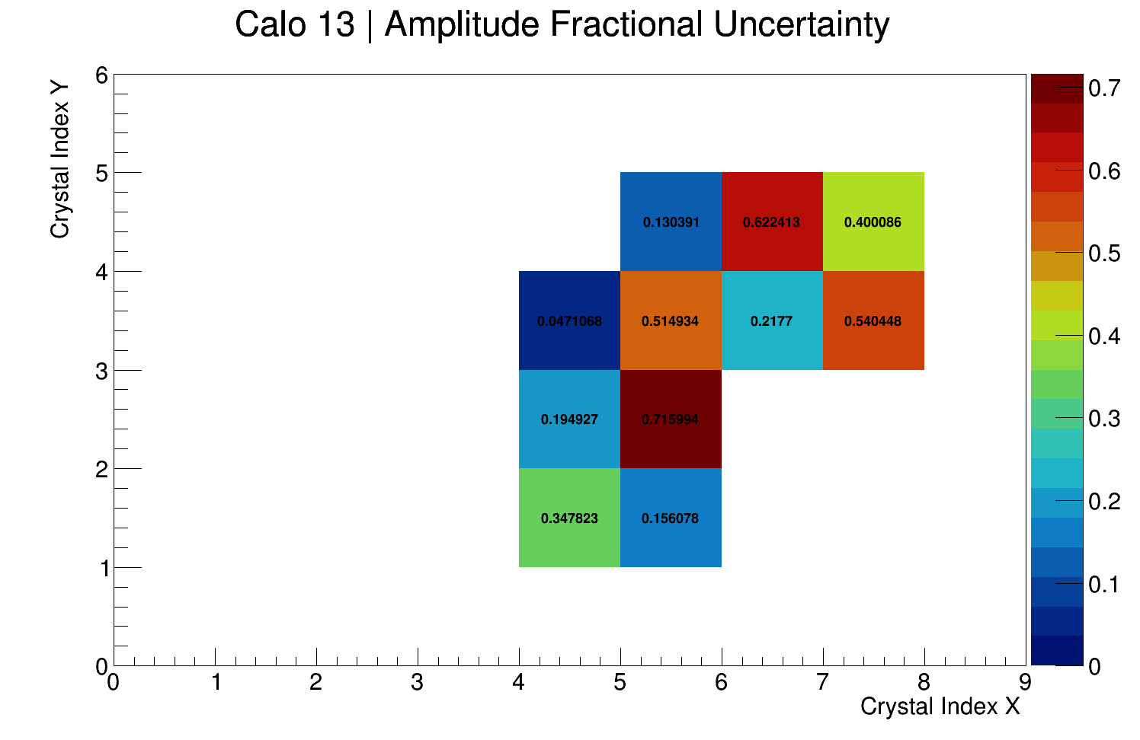
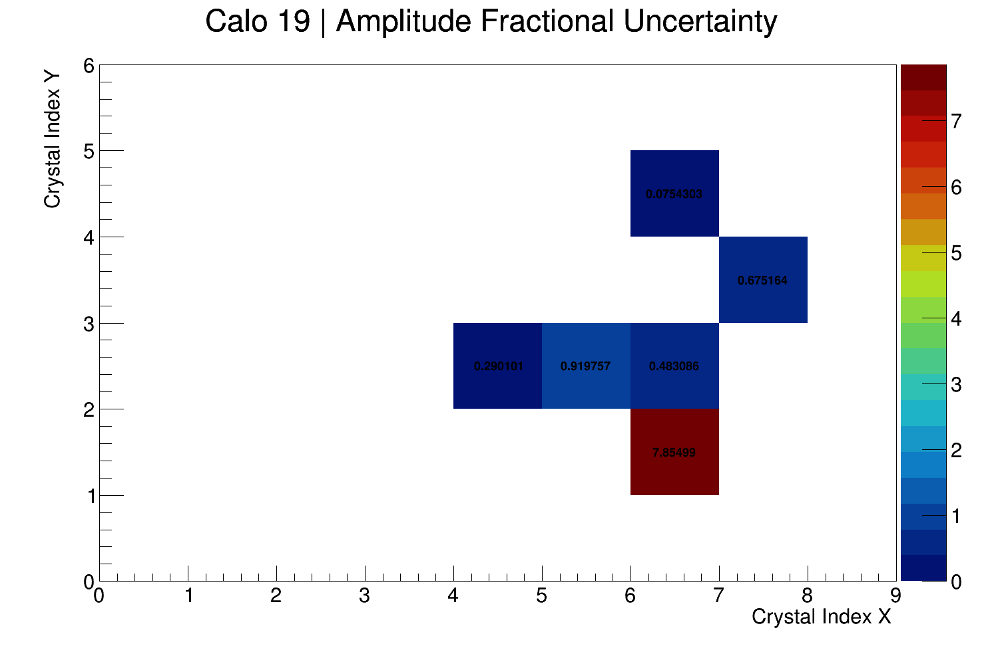
Cuts Illustration (Fractional Uncertainty)

Slide 11
Good Crystal (Calo 13 #22) vs. Bad Crystal (Calo 19 #15)

Slide 12
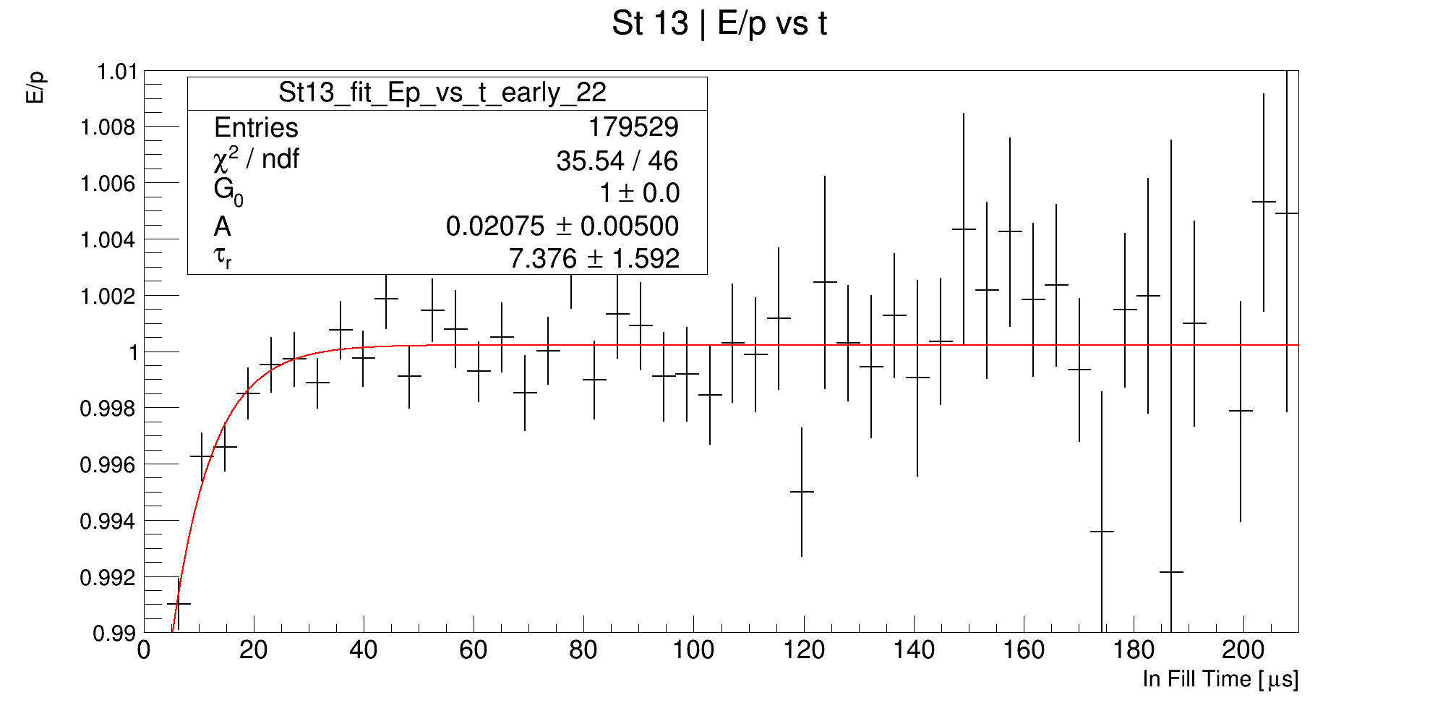
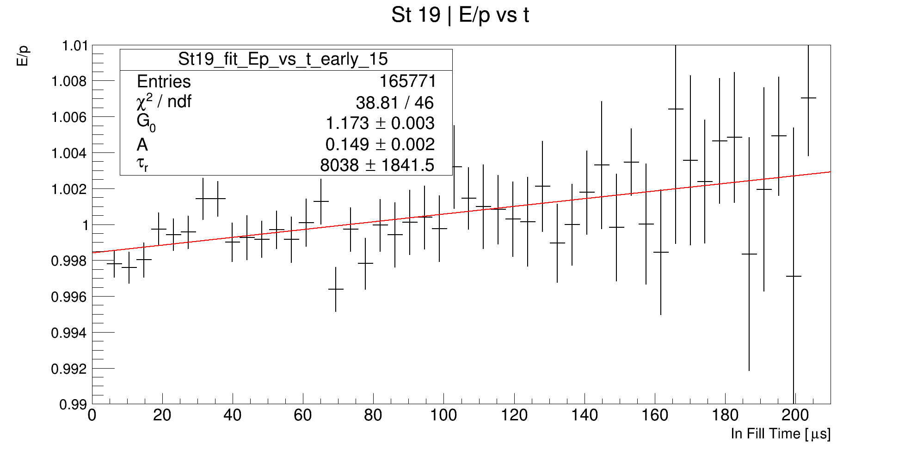
Good Crystal (Calo 13 #22) vs. Bad Crystal (Calo 19 #15)
Both survive the Q cuts, both are in the fiducial region of the calorimeter.

Slide 13
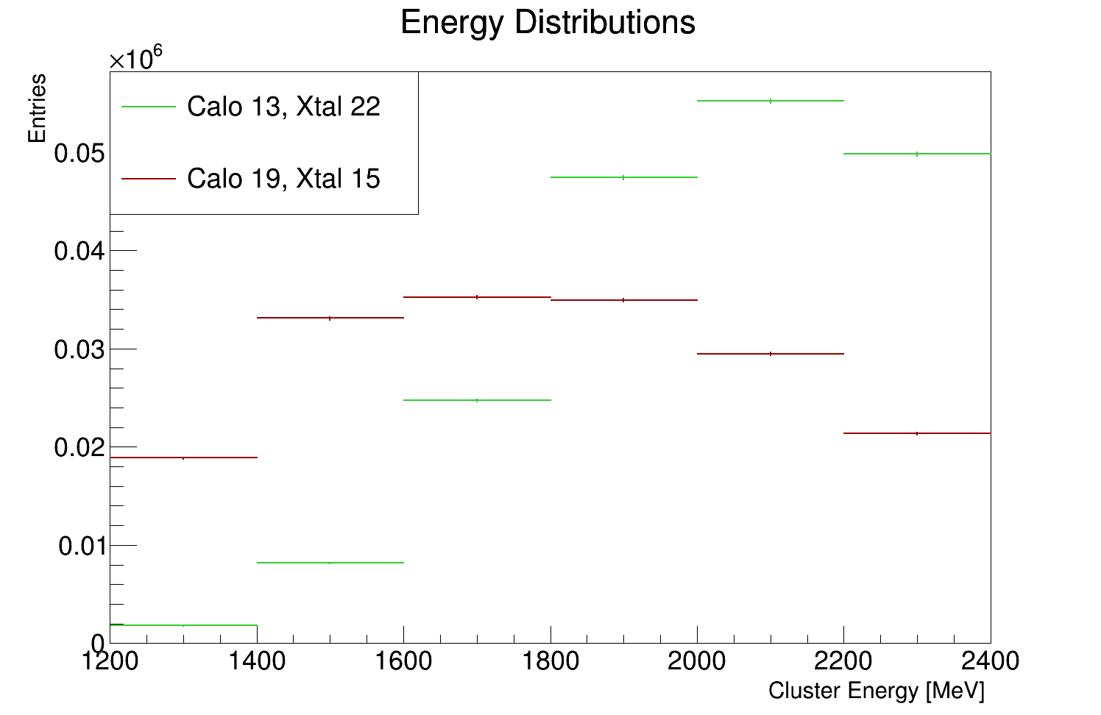
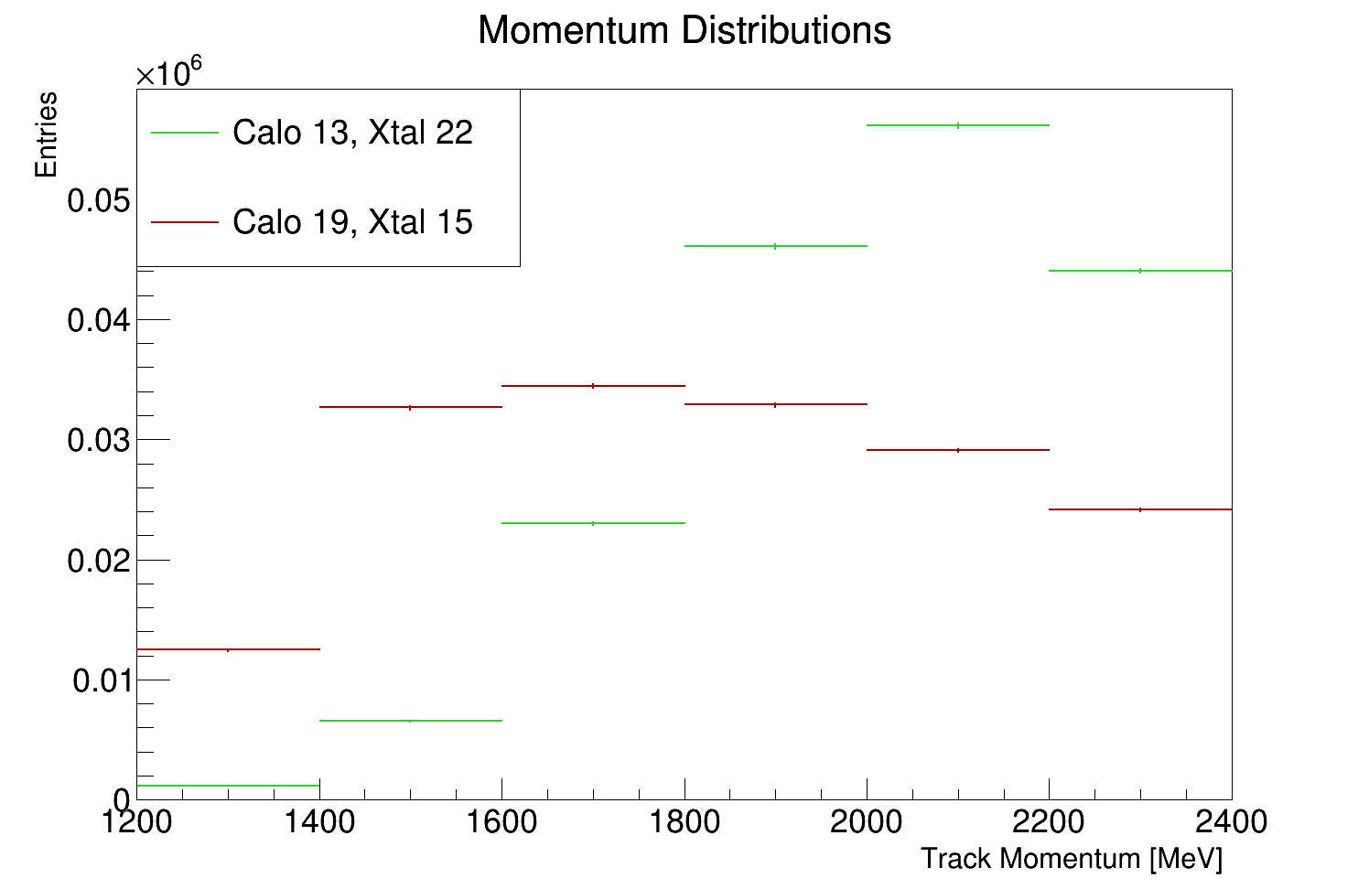
Good Crystal (Calo 13 #22) vs. Bad Crystal (Calo 19 #15)
Very weird...

Slide 14
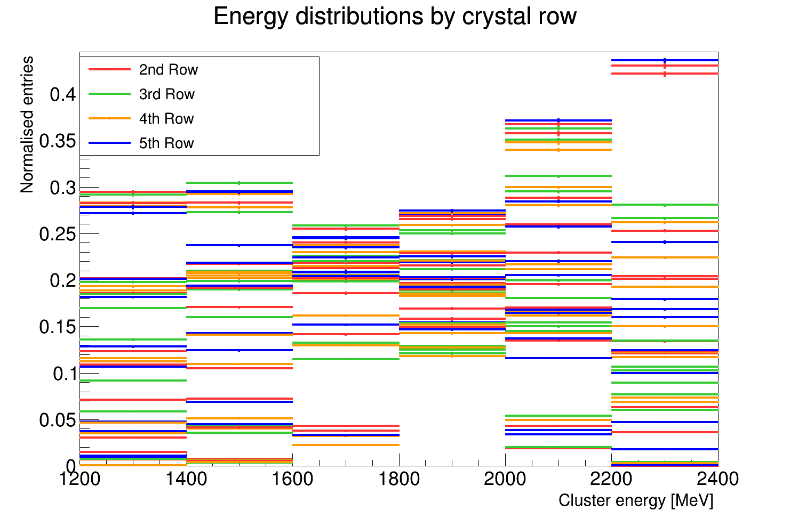
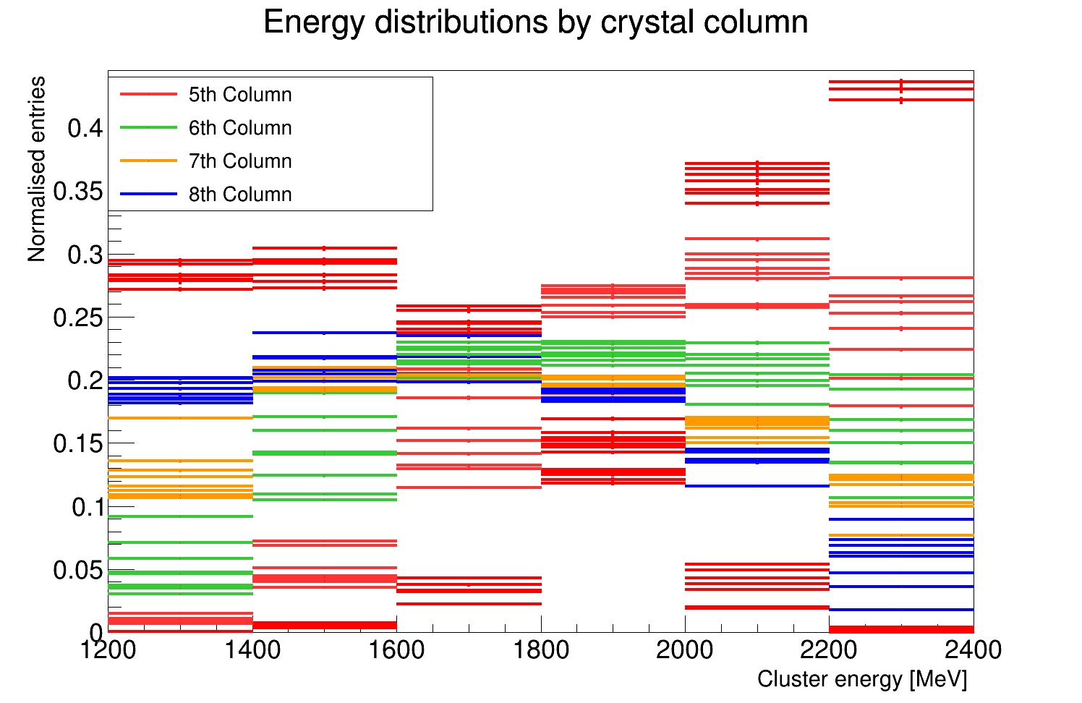

Slide 15
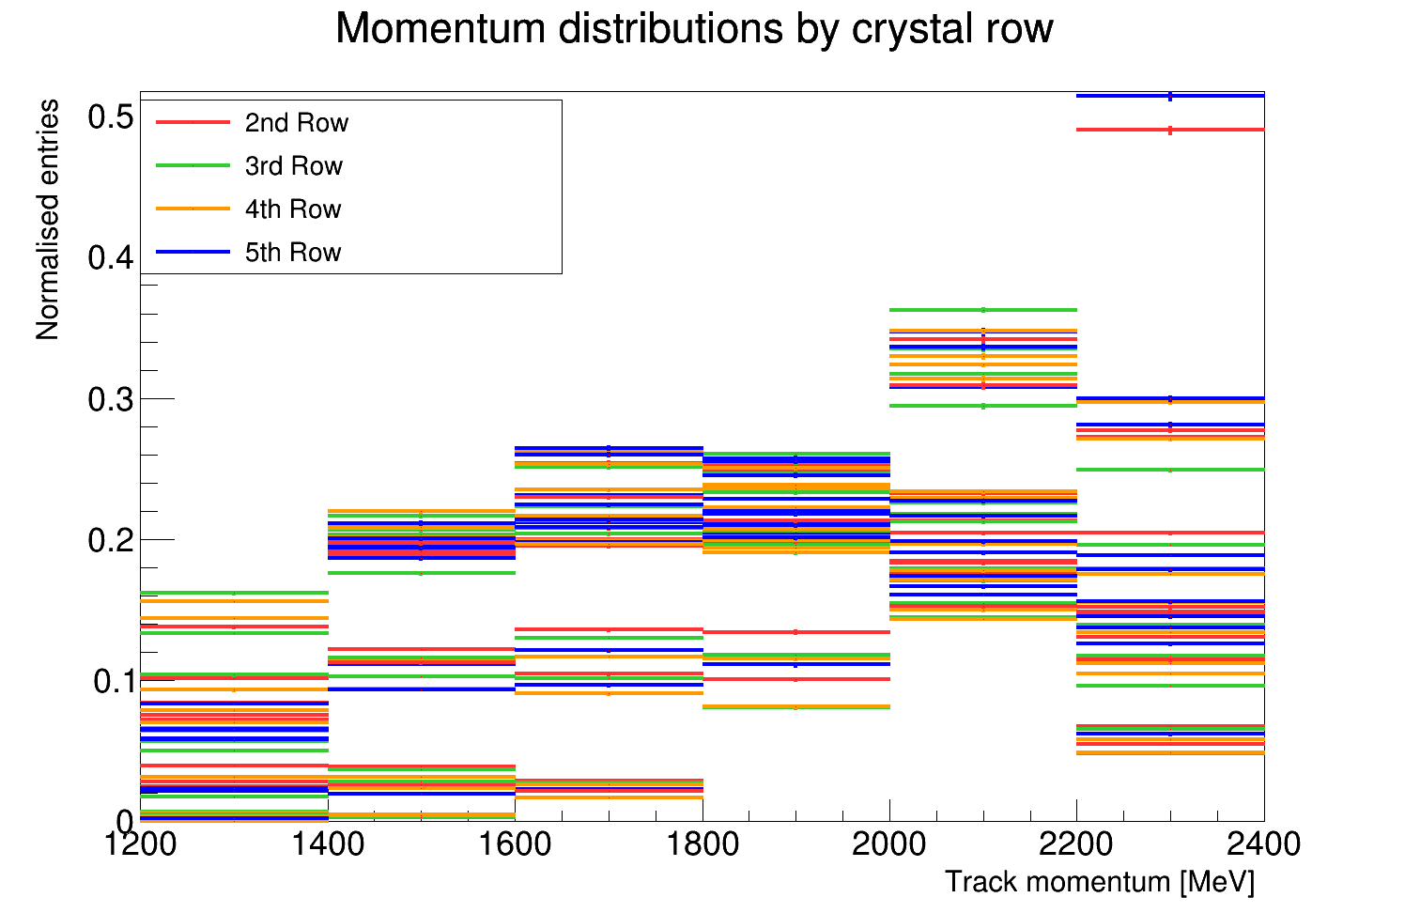
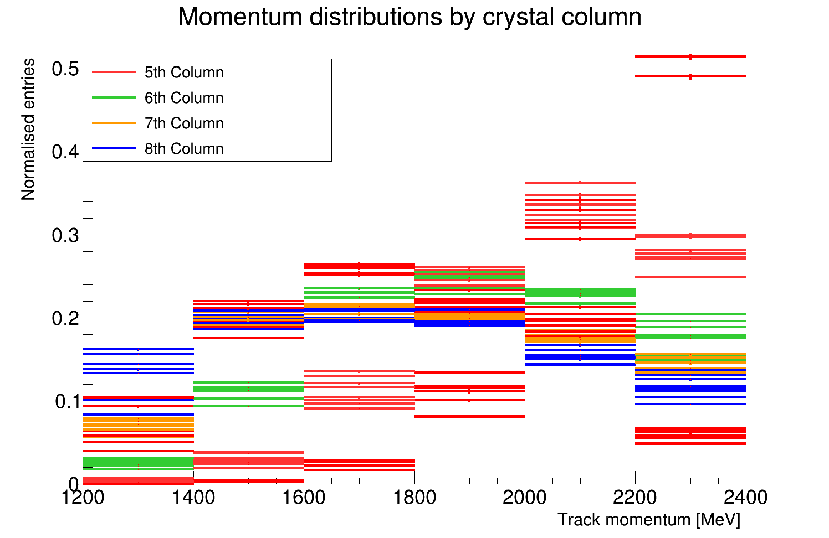

Slide 16
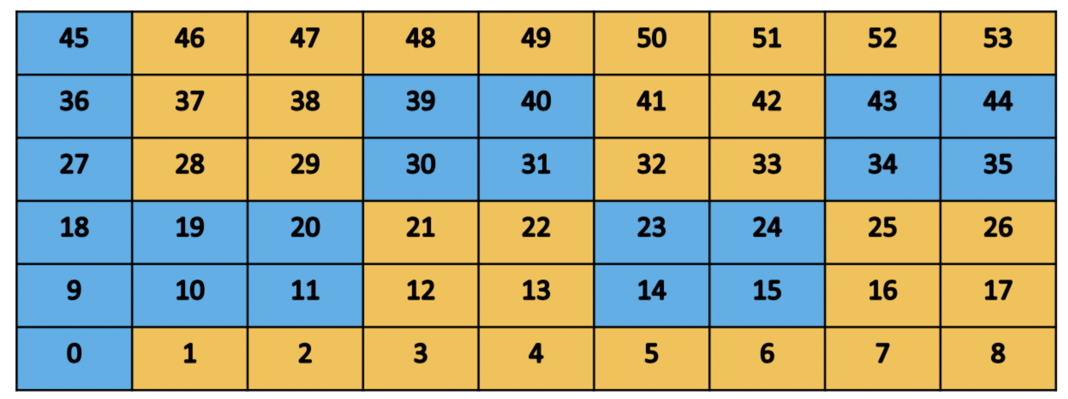

Slide 17
Summary
No explanation for the difference in E and p
I’m hoping that higher statistics will have an effect (this is all 60hr)
Currently almost finished incorporating this work into the TrackCaloMatching art module, so I can run over the 9 day dataset

